Slide 1

Advanced Data Integrity Patterns using Triggers and Check Constraints
Database Management System | SQL and Advanced Query Formulation
Course: Database Management System | Chapter: SQL and Advanced Query Formulation | Program: B.TECH-CSE, B.TECH CSE - CYBER SECURITY, B.TECH CSE - DATA
DISCOVER · LEARN · EMPOWER
Notes:
Welcome everyone to today's session on Advanced Data Integrity. We will explore how to enforce complex business rules that standard SQL constraints cannot handle. This lecture is crucial for designing robust database systems that prevent data corruption at the source.

Slide 2
Course Outcomes
SLIDE 2 / 14
Course Outcome
CO | BT LEVEL | DESCRIPTION
CO1 | BT2 | Explain database architecture, relational model concepts and formal query language foundations including relational algebra and relational calculus.
CO2 | BT3 | Apply relational algebra, relational calculus and SQL constructs to formulate correct and efficient database queries.
CO3 | BT4 | Analyze functional dependencies and design normalized relational schemas up to 5NF ensuring lossless join and dependency preservation.
CO4 | BT4 | Analyze transaction schedules and concurrency control mechanisms to determine serializability, recoverability and correctness.
CO5 | BT5 | Evaluate storage structures, indexing strategies and query optimization techniques for performance, scalability and reliability.
Chandigarh University
2 / 14
Notes:
Today's content directly supports our Course Outcomes. CO3 is addressed as we design schemas that maintain integrity beyond simple normalization. CO4 is critical because triggers and constraints must behave correctly during concurrent transactions to ensure data consistency.

Slide 3
Learning Objectives
SLIDE 3 / 14
Learning Outcomes
1
Analyze the distinct roles of Check Constraints versus Triggers in data validation.
2
Evaluate the performance implications of using complex triggers on large datasets.
3
Design custom triggers to enforce multi-column business rules and cross-table integrity.
4
Apply trigger logic to prevent invalid state transitions in order processing systems.
5
Compare the execution order and atomicity of constraints against trigger mechanisms.
Chandigarh University
3 / 14
Notes:
By the end of this lecture, you will be able to distinguish when to use a simple check versus a complex trigger. We will analyze how these tools impact system performance and data consistency. You will learn to design triggers that handle scenarios where standard SQL constraints fall short.

Slide 4
Check Constraints
SLIDE 4 / 14
Definition and Scope
1
Check constraints enforce domain integrity by validating single-row data before insertion.
2
They operate at the column or table level without accessing other database tables.
3
Syntax uses the CHECK keyword followed by a boolean expression condition.
4
Constraints are evaluated immediately during the INSERT or UPDATE statement execution.
5
They cannot reference functions that modify data or access other tables.
Chandigarh University
4 / 14
Notes:
Check constraints are the first line of defense for data integrity. They are simple boolean expressions that must evaluate to true for a row to be saved. For example, ensuring a salary column never contains a negative value is a classic use case.

Slide 5
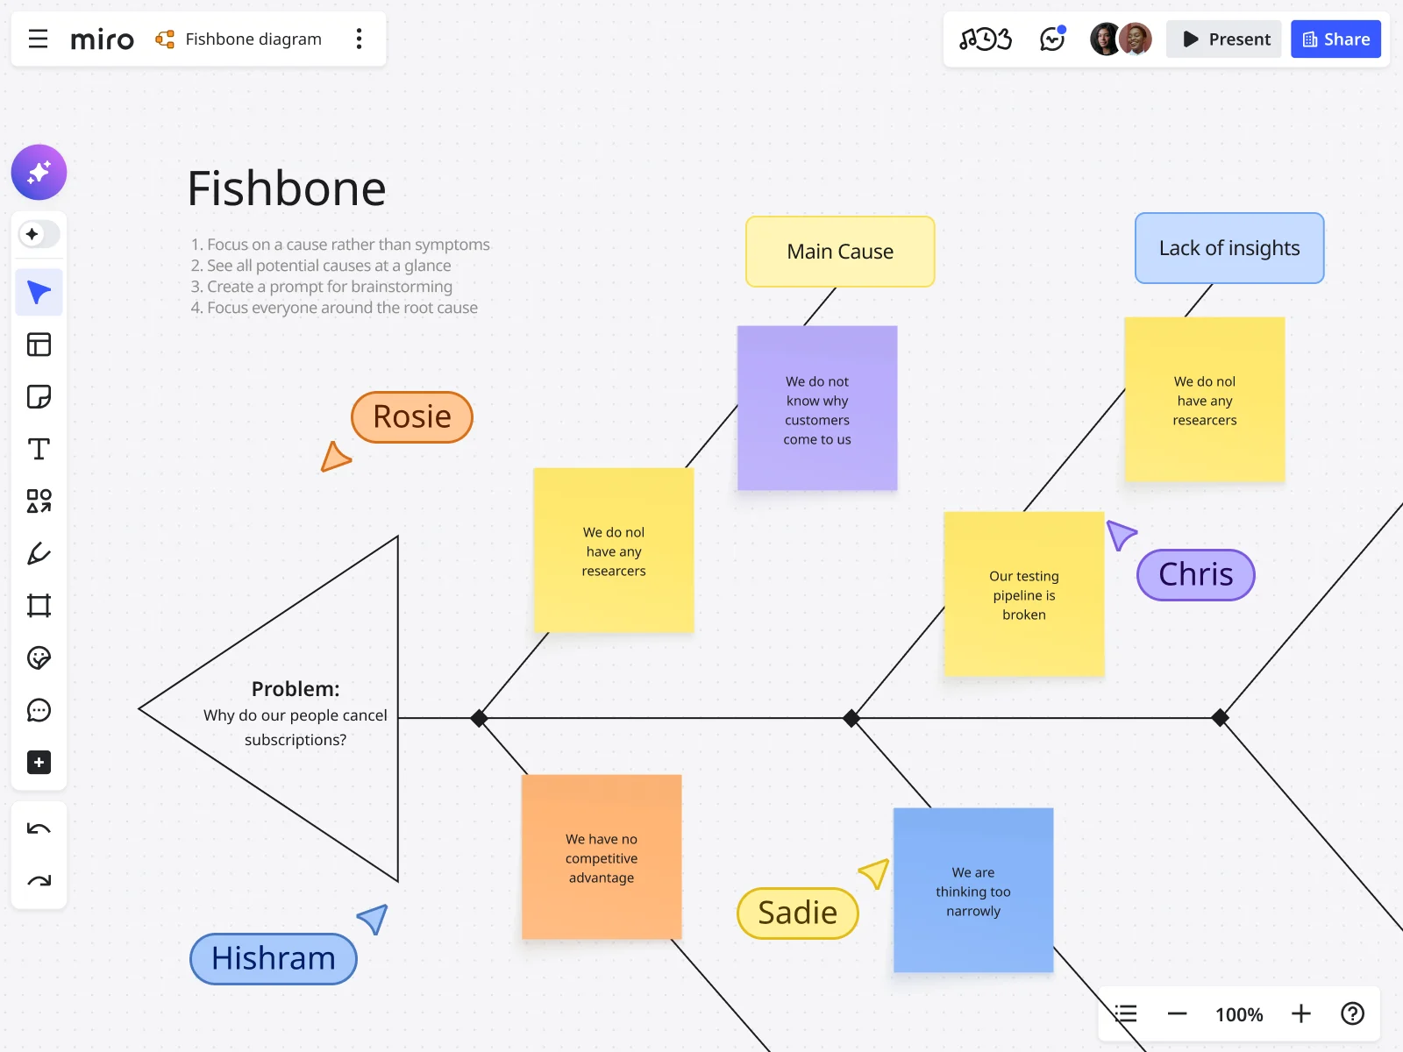
Lecture
SLIDE 5 / 14
Limitations of Check Constraints
1
Check constraints cannot reference columns from other tables in the database.
2
They cannot execute stored procedures or complex user-defined functions.
3
They cannot enforce referential integrity across multiple tables dynamically.
4
They cannot prevent updates that violate rules based on aggregate data.
5
Complex logic requiring multiple rows often exceeds the scope of CHECK.
Source: images.ctfassets.net
Chandigarh University
5 / 14
Notes:
While powerful, check constraints have strict limitations. They cannot look at other tables, meaning you cannot enforce rules like 'total order value must not exceed credit limit' using only a check constraint. This limitation necessitates the use of triggers for complex scenarios.

Slide 6
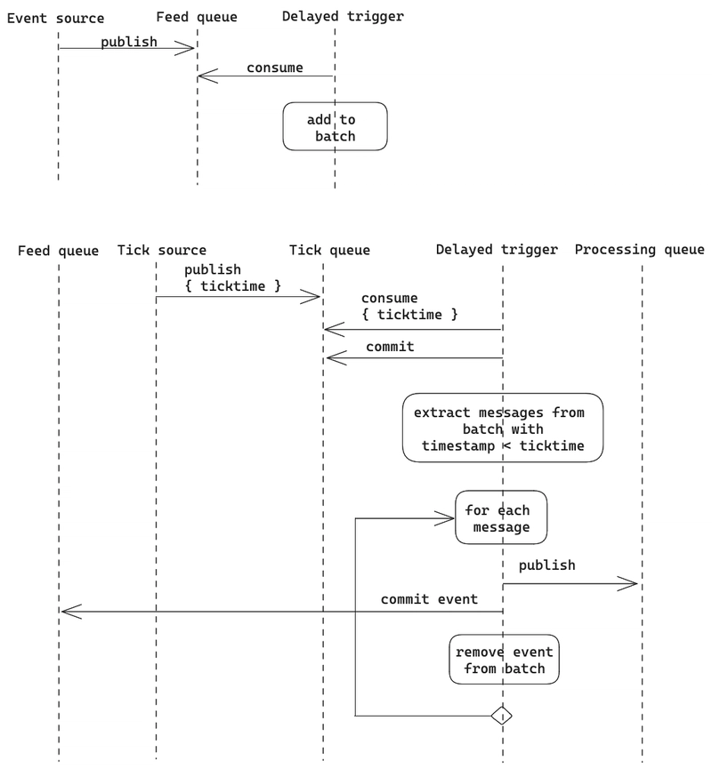
Triggers
SLIDE 6 / 14
Definition and Mechanism
1
Triggers are stored procedures that automatically execute in response to events.
2
Events include INSERT, UPDATE, or DELETE operations on specific tables.
3
They can fire BEFORE or AFTER the triggering SQL statement completes.
4
Triggers can access both OLD and NEW row data during execution.
5
They allow for complex logic involving multiple tables and aggregates.
Source: media2.dev.to
Chandigarh University
6 / 14
Notes:
Triggers act as automated guardians that wake up whenever data changes. They can run before the data is written to enforce rules or after to log changes. This flexibility allows them to handle logic that check constraints simply cannot manage.

Slide 7
Lecture
SLIDE 7 / 14
BEFORE vs AFTER Triggers
1
BEFORE triggers allow modification of the row data before it is saved.
2
They are ideal for defaulting values or rejecting invalid data early.
3
AFTER triggers execute after the row is successfully committed to the table.
4
They are used for logging changes or updating related summary tables.
5
Using BEFORE triggers prevents unnecessary I/O if data is rejected.
Chandigarh University
7 / 14
Notes:
The timing of your trigger matters significantly. A BEFORE trigger can modify the incoming data, effectively changing the user's request before it hits the disk. An AFTER trigger is better for auditing, as it sees the final committed state of the data.

Slide 8
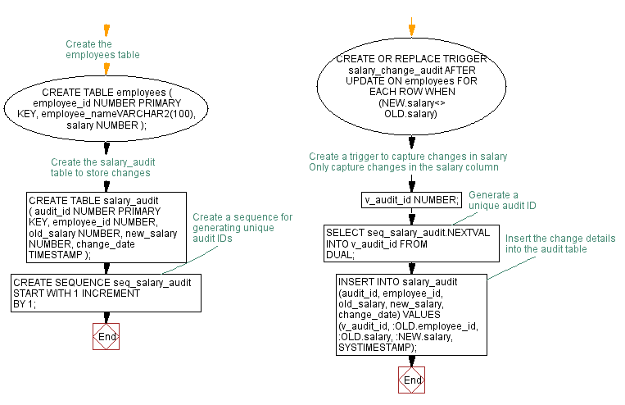
Worked Example
SLIDE 8 / 14
Salary Validation
GOVERNING EQUATION
Trigger logic: SELECT max(salary) FROM employees WHERE dept_id = NEW.dept_id
SCENARIO
Ensure manager salary is at least 10% higher than subordinates.
CALCULATION
IF NEW.salary < (max_subordinate × 1.1) THEN RAISE EXCEPTION.
RESULT
Database rejects the insert if the rule is violated.
• Check constraint fails because it cannot compare rows in the same table.
Source: www.w3resource.com
Chandigarh University
8 / 14
Notes:
Consider a scenario where a manager's salary must exceed their team's average. A check constraint cannot do this because it cannot query other rows. We write a trigger that calculates the maximum subordinate salary and compares it to the new manager's proposed salary.

Slide 9
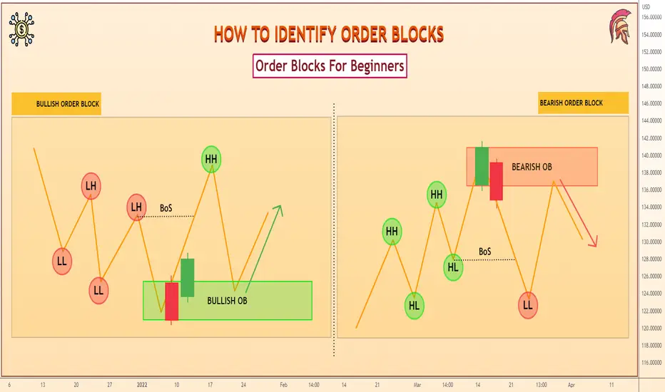
Worked Example
SLIDE 9 / 14
Inventory Logic
GOVERNING EQUATION
Logic: SELECT stock_qty FROM Inventory WHERE item_id = NEW.item_id
SCENARIO
Prevent order quantity exceeding current available stock.
CONDITION
IF NEW.quantity > stock_qty THEN RAISE EXCEPTION.
OUTCOME
Transaction rolls back immediately to maintain inventory accuracy.
• Trigger fires BEFORE INSERT on the Orders table.
Source: s3.tradingview.com
Chandigarh University
9 / 14
Notes:
In inventory management, overselling is a critical failure. We use a trigger to check current stock levels before allowing an order. If the requested quantity exceeds available stock, the trigger raises an exception, rolling back the transaction instantly.

Slide 10
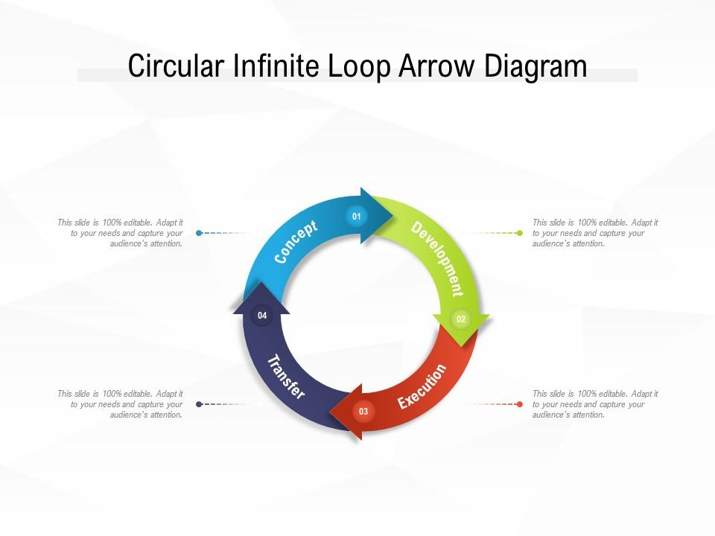
Common Pitfalls
SLIDE 10 / 14
Recursive Triggers
EXAMPLE
An UPDATE trigger that fires on UPDATE creates a cycle.
SOLUTION
Use conditional logic to prevent self-triggering updates.
SOLUTION
Enable the database to disable triggers during specific operations.
RISK
Infinite loops can crash the database server or lock resources.
• A trigger modifying the same table can cause infinite recursion loops.
Source: www.slideteam.net
Chandigarh University
10 / 14
Notes:
One of the most dangerous pitfalls is recursive triggers. If a trigger updates the same table it is attached to, it can fire again and again. You must add logic to prevent the trigger from firing on its own updates to avoid crashing the system.

Slide 11
Common Pitfalls
SLIDE 11 / 14
Performance Overhead
BEST PRACTICE
Keep trigger logic minimal and efficient.
• Triggers execute for every single row affected by a bulk operation.
• Complex logic inside triggers can significantly slow down batch updates.
• Network latency increases if triggers call remote stored procedures.
• Debugging trigger logic is difficult as errors occur silently in the background.
Chandigarh University
11 / 14
Notes:
Performance is a major concern with triggers. If you have a bulk update of 10,000 rows, the trigger fires 10,000 ×. Complex logic inside that trigger can turn a fast operation into a slow one. Always keep trigger code lean and efficient.

Slide 12
Lecture
SLIDE 12 / 14
Integration with CO3 and CO4
1
Triggers support CO3 by enforcing integrity in normalized schemas beyond 3NF.
2
They ensure dependency preservation when business rules span multiple tables.
3
Triggers support CO4 by maintaining consistency during concurrent transactions.
4
Proper locking in triggers ensures serializability of complex updates.
5
Atomic trigger execution guarantees recoverability of partial transaction failures.
Chandigarh University
12 / 14
Notes:
This topic ties back to our core outcomes. Triggers allow us to enforce rules that support CO3, ensuring our normalized schemas remain valid under complex business logic. For CO4, triggers must be designed to handle concurrency safely, ensuring that transactions remain serializable and recoverable.

Slide 13
Lecture
SLIDE 13 / 14
Key Takeaways
1
Use Check Constraints for simple, single-row validation rules.
2
Use Triggers for complex, multi-row, or cross-table integrity rules.
3
Always test triggers for recursion and performance bottlenecks.
4
BEFORE triggers modify data; AFTER triggers log or update summaries.
5
Triggers are powerful but must be used judiciously to avoid overhead.
Chandigarh University
13 / 14
Notes:
To summarize, check constraints are your first line of defense for simple rules. Triggers are your tool for complex logic but come with performance costs. Always design them carefully to avoid recursion and ensure they support your transactional integrity goals.

Slide 14
Lecture
SLIDE 14 / 14
References
1
Fundamentals of Database Systems — Ramez Elmasri & Shamkant B. Navathe
2
Database System Concepts — Silberschatz, Korth & Sudarshan
3
Database Management Systems — Raghu Ramakrishnan & Johannes Gehrke
4
Oracle/MySQL Documentation — Oracle
Chandigarh University
14 / 14
Notes:
For further reading, please refer to the standard texts by Elmasri, Silberschatz, and Ramakrishnan. These books provide deep insights into database internals and trigger implementation. The Oracle and MySQL documentation offers specific syntax details for your practical assignments.

